Slide 1

Customer Overview

Slide 2
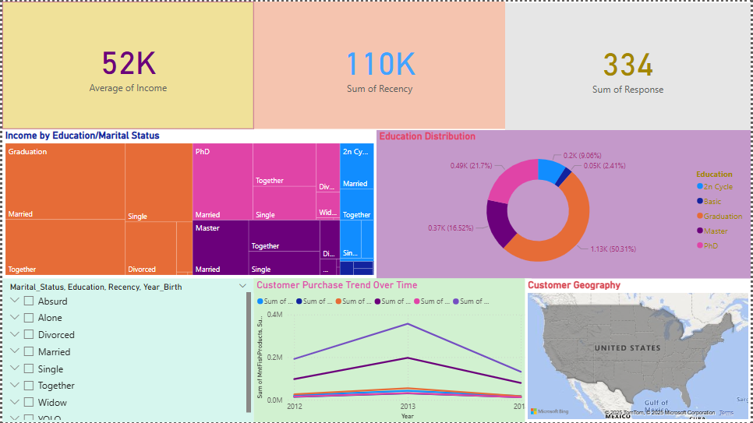

Slide 3
Purchasing Behaviour

Slide 4
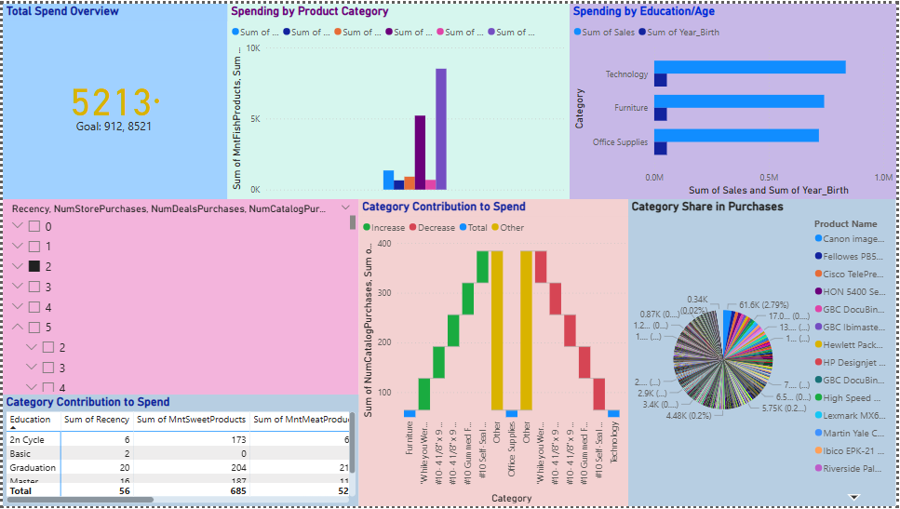

Slide 5
Marketing Campaign Analysis

Slide 6
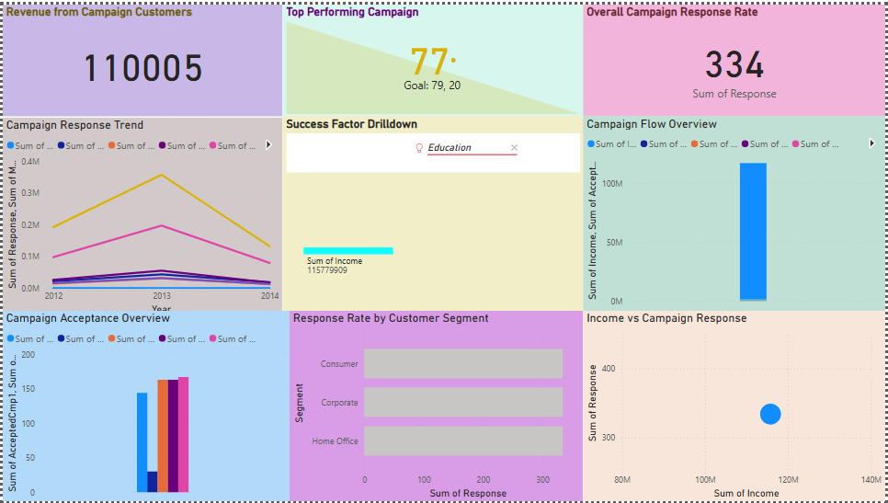

Slide 7
Sales Dashboard

Slide 8
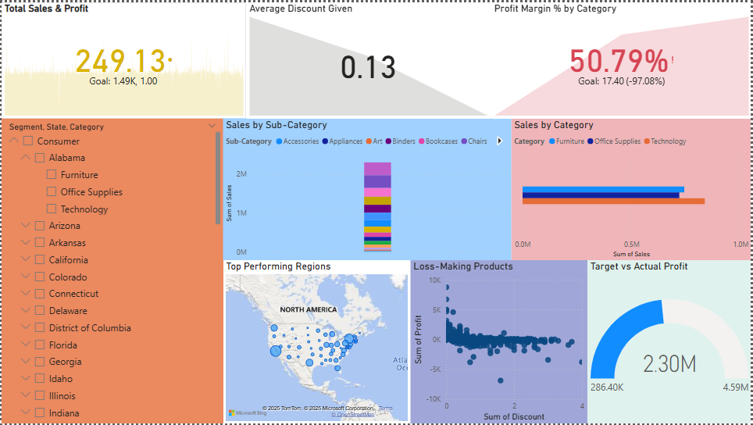

Slide 9
Shipment and Orders Analysis

Slide 10
